Slide 1
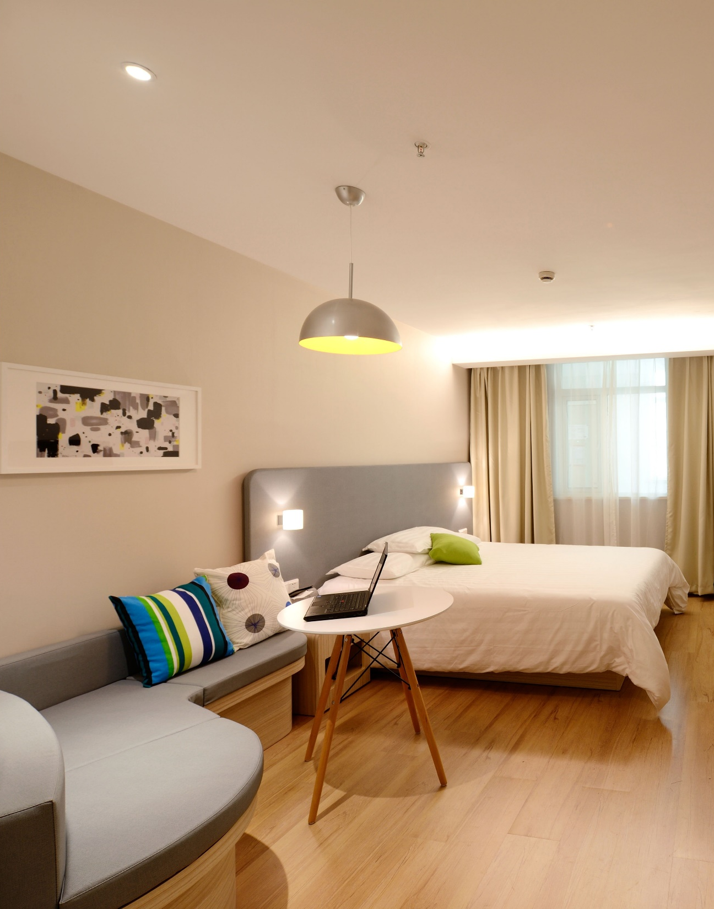

Case Study – Insights Data Analysis Managers & Lead Data Analyst
By Chandana, Sowmya & Jayant

Slide 2
About Airbnb
Airbnb is an online marketplace that allows people to rent out their homes, apartments, and other types of properties to travelers. The company was founded in 2008 by Brian Chesky, Joe Gebbia, and Nathan Blecharczyk, and has since become one of the most successful and well-known companies in the sharing economy.
The Airbnb platform allows hosts to list their properties for rent, and guests to search for and book these properties. Hosts can choose the price, availability, and rules for their listings, and can communicate with guests directly through the platform. Guests can search for properties based on their travel dates, location, and other preferences, and can book properties and pay through the platform.
Airbnb has a wide range of properties available for rent, including apartments, houses, villas, cabins, treehouses, and even castles. The platform is available in over 220 countries and regions, and has over 4 million hosts and 800 million guest arrivals to date.

Slide 3

Problem Statement
For the past few months, Airbnb has seen a major decline in revenue. Now that the restrictions have started lifting and people have started to travel more, Airbnb wants to make sure that it is fully prepared for this change
The different leaders at Airbnb want to understand some important insights based on various attributes in the dataset so as to increase the revenue such as –
Which type of hosts to acquire more and where?
The categorization of customers based on their preferences.
What are the neighborhoods they need to target?
What is the pricing ranges preferred by customers?
The various kinds of properties that exist w.r.t. customer preferences.
Adjustments in the existing properties to make it more customer-oriented.
What are the most popular localities and properties in New York currently?
How to get unpopular properties more traction?

Slide 4






Objective to Achieve
Know Next Best Step
Right Property Acquisition
Customer Experience
To Prepare for the Next Best Step
Acquisition of the best properties at best price
Managing Properties Listing to get every property enough Traction

Slide 5
Approach
Understanding Problem Statement
Understanding the Data
Data Preparation & EDA by using Jupiter Notebook
Data Analysis through Tableau & Power BI

Slide 6
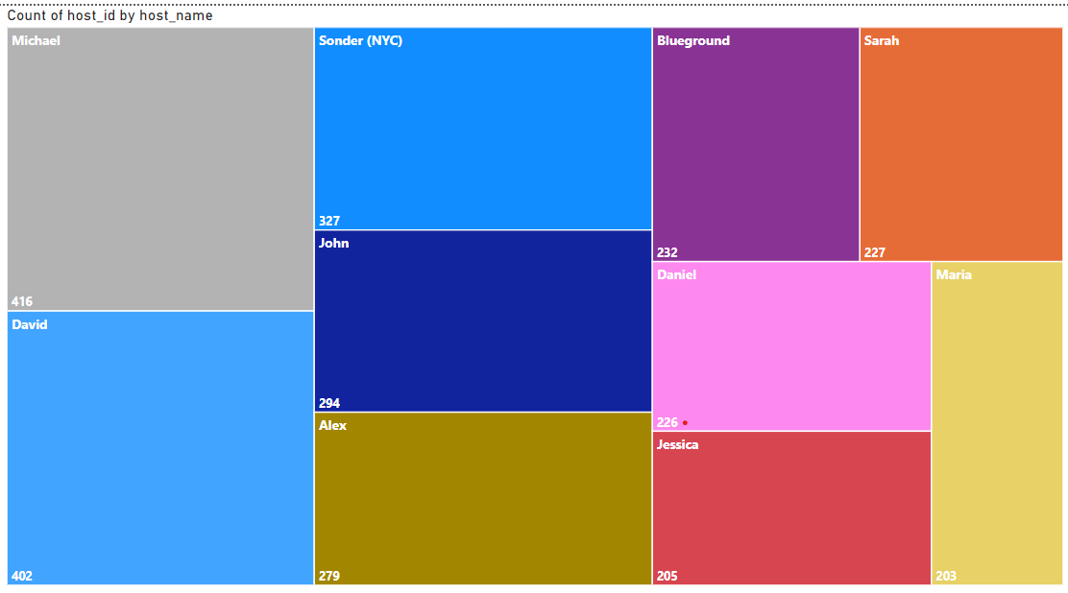
Top 10 Host
Host with Michael in the name has maximum number of Booking i.e. 416.
Sonder (NYC ) Host is the third large popular host.
Other hosts like Alex, Jessica, John and Daniel also fall under top 10 hosts.

Slide 7
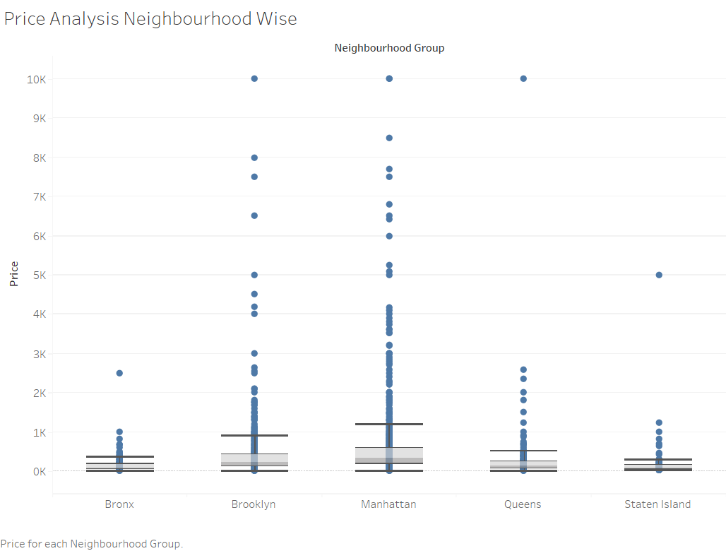
Price Analysis: Neighborhood Wise
Brooklyn & Manhattan has most of the outliers Price wise
Manhattan has highest range of prices of listings.
Bronx is the most affordable
Median price of all neighbourhood groups lying between $ 80 to $ 300.
Queens has an outlier pricing which is close to 10K
Price of accommodation in Manhattan is pretty higher and affordable for high class people. Undoubtedly, its beauty is enough to attract anyone.

Slide 8
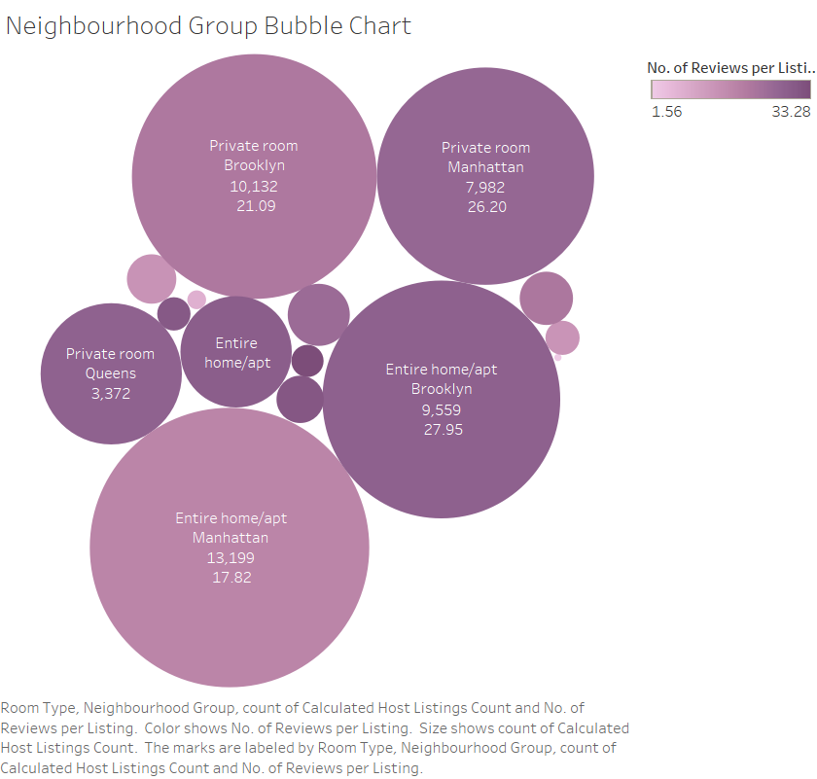
Neighborhood Group Details
People prefer Entire Home/Apt listings in Manhattan, there highest no of listings
Brooklyn has highest private room listings
Queens listings also have Highest reviews per listing
Bronx shared room has Lowest reviews
Except Manhattan, all areas performed poorly in shared rooms

Slide 9
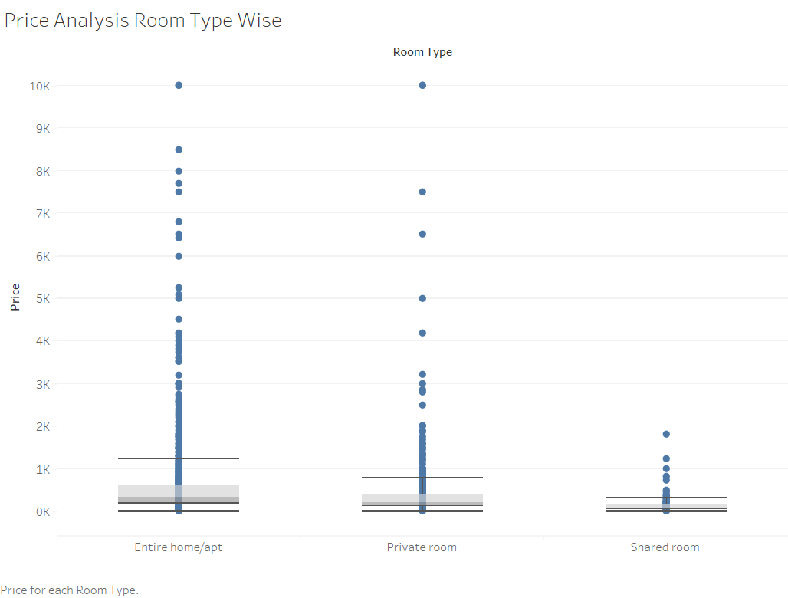
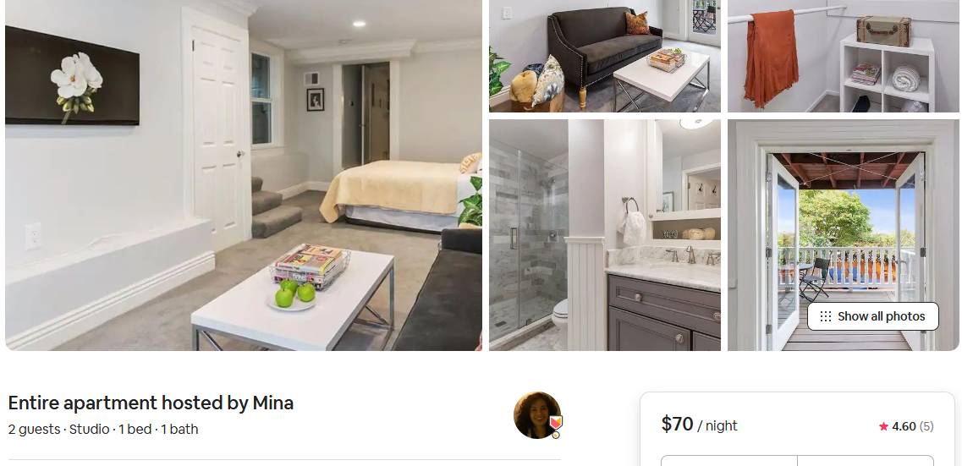
Preferred Room Type
Shared room price is lower than the Entire Home
Private room price has outlier with highest price
Entire house/Apt listings are highest amongst the room types

Slide 10
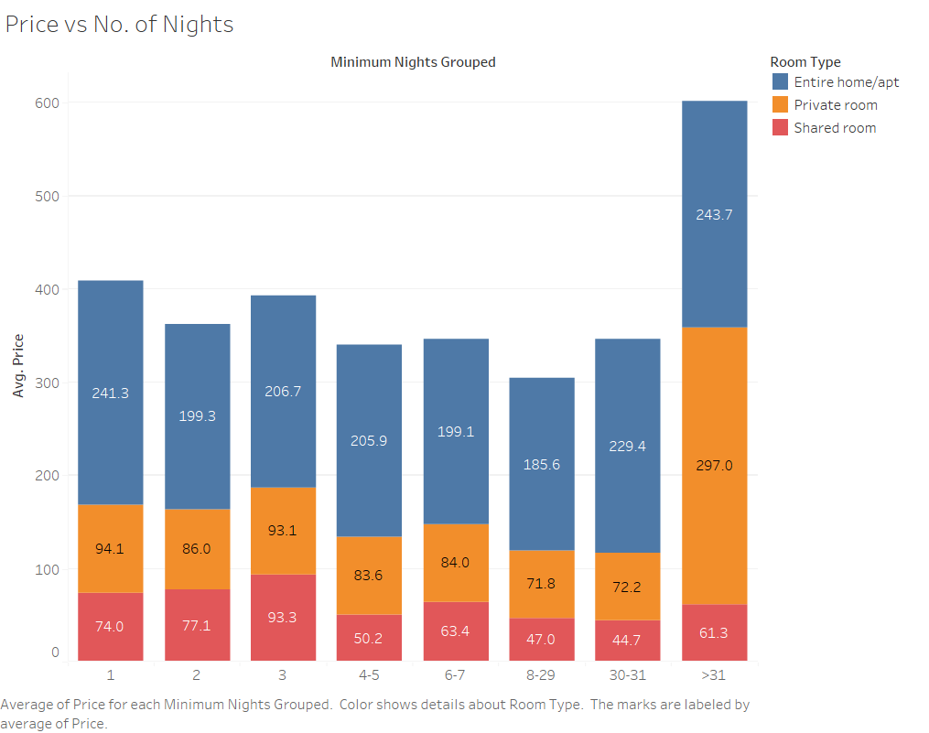
Avg Price as per No of Night
Private Room price is very high for over 31 nights
Shared Room for 30 to 31 nights price is the least
Entire home/apt 8 to 29 nights costs less
Shared room price per 3 nights is higher than 4 to 5 Nights
The listings with Minimum nights 1-5 have the most number of bookings.

Slide 11
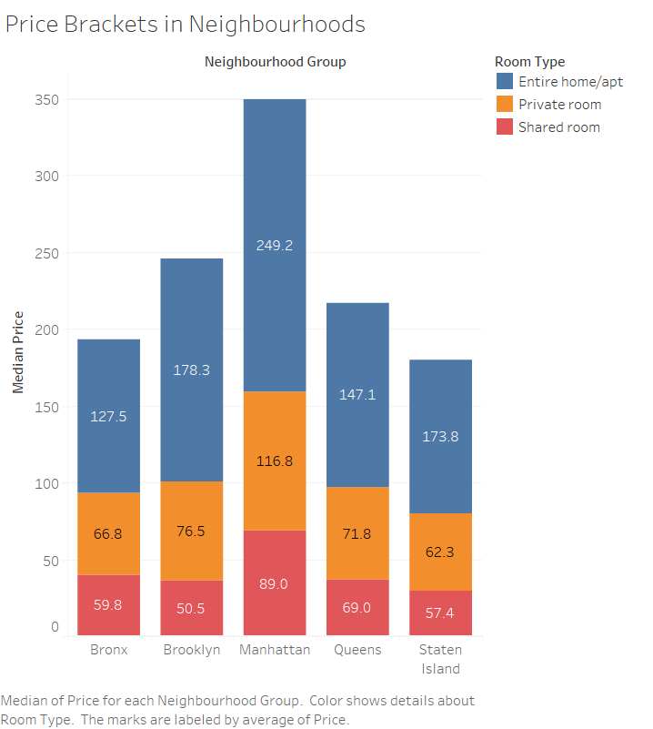
Pricing Neighourhoods
Entire home/apt’s price is ~100% more than private rooms except Brooklyn and Staten Island with ~150%
Private room’s price is ~10% more than shared rooms except Brooklyn and Manhattan with ~40%
Manhattan is costliest overall and the cheapest are:
Entire apt: Bronx
Private room: Staten Islands
Shared room: Brookly

Slide 12
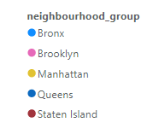
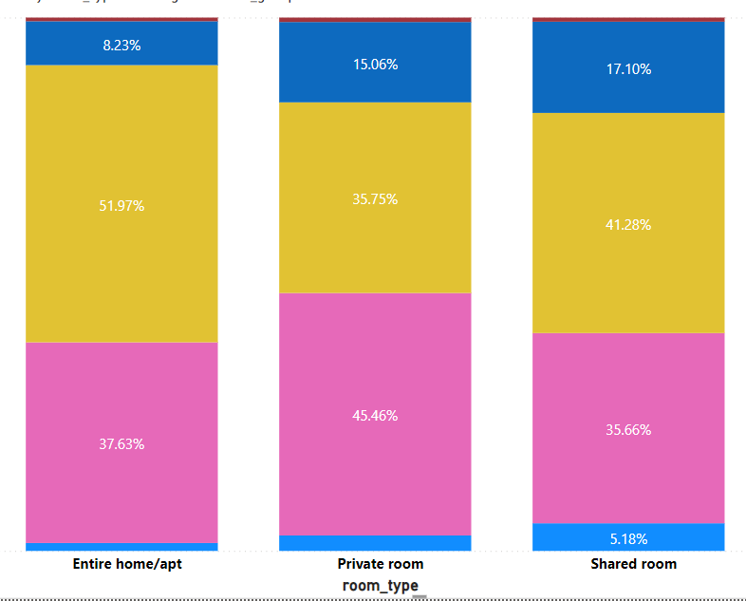
365 Availability by Room type
52% of Entire homes available in Manhattan
45.46% Private rooms are available in Brooklyn
Least no of entire homes available in Bronx
Only 8.23 % Entire homes available in Queens
Only 5% shared rooms available in Bronx
Private rooms available in less in Manhattan

Slide 13
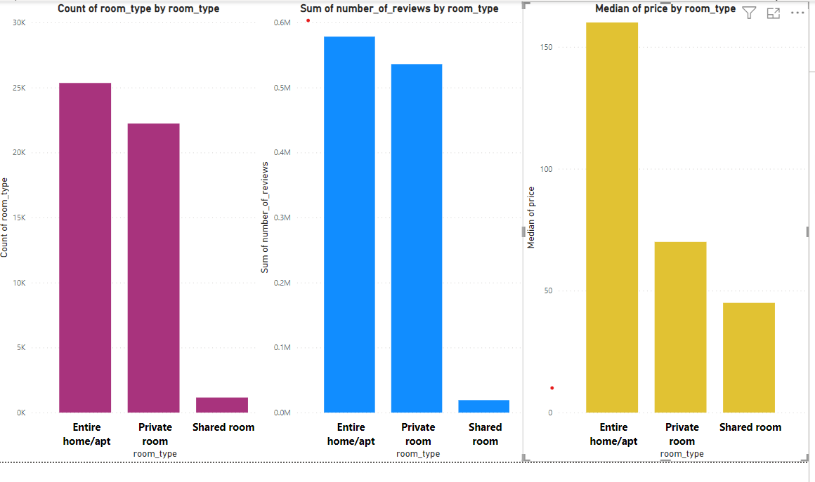
Additional Insights
Entire house/Apt listings are higher compared to Private Room & Shared room listing
Highest no of reviews for Entire Home only
Median prices is seen little higher in Shared rooms
Least no of reviews for Shared rooms

Slide 14
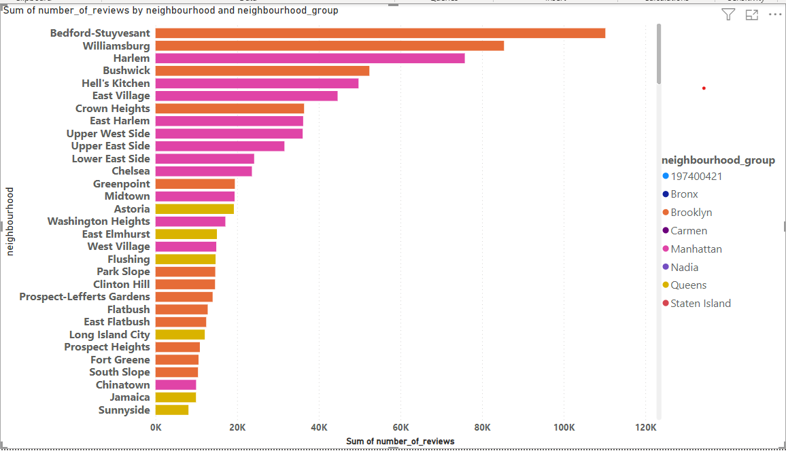
Reviews by Neibourhood & Group
Bedford-Stuyvesant has highest no of reviews of 110194
Sunnyside has lowest reviews of 8070
Crown Heights, East Harlem & Upper west side have 36K+ review all most same

Slide 15
Appendix
Data Attributes Appendix:
Host listing information like host name, neighbourhood, latitude and longitude
Customer preference information like no of reviews & no of reviews per month
Data Methodology Appendix:
• Conducted a thorough analysis of New York Airbnbs Dataset.
• Cleaned the data set using python.
• Used group aggregation, pivot table and other statistical methods.
•Used Tableau & Power BI to visualize & Created charts
As there are outliers existed in price field, used median of price instead of mean for analysis purposes

Slide 16
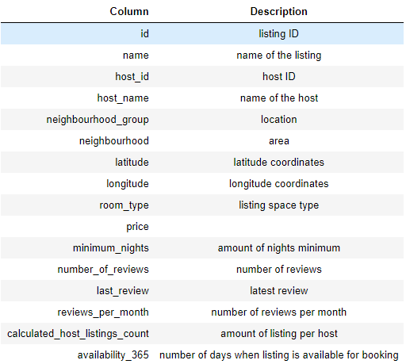
Appendix Date Source
The columns in the dataset are self-explanatory. We can refer to the
diagram given below to get a better idea on what each column is & description of the same.

Slide 17
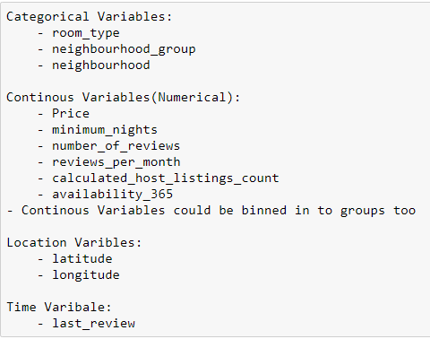
APPENDIX - DATA ASSUMPTIONS

Slide 18
Thank you

